Slide 1
HE Designated Funds Cycling Safety and integration (CSI)
20/02/2019
Notes:
Purpose of meeting
What are we hoping to achieve
How much is it costing and where the money is coming from
What will it look like (Briefly describe the design principles, schemes - their issues and opportunities)
When will it happen (milestones/ Next steps/ Future consultation and engagement)

Slide 2
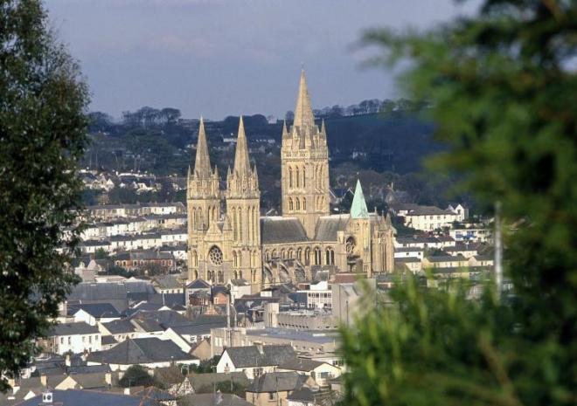
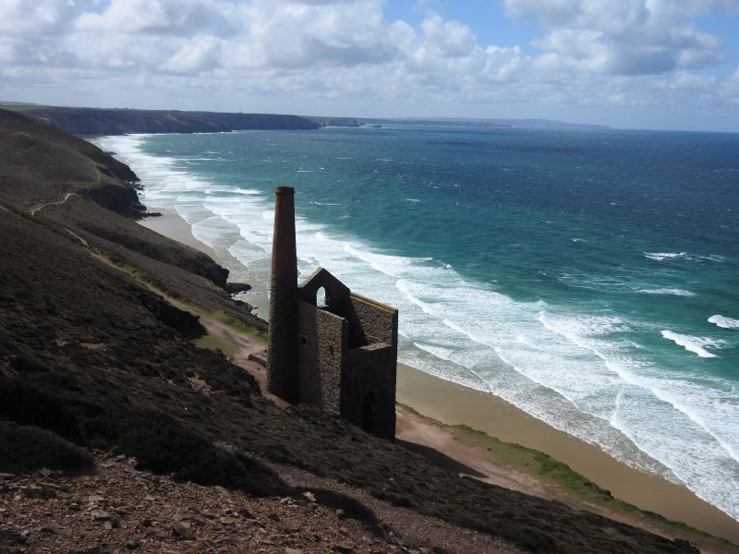
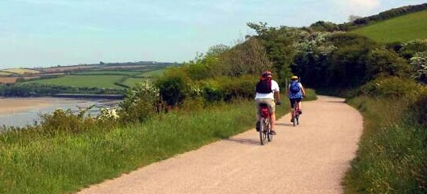
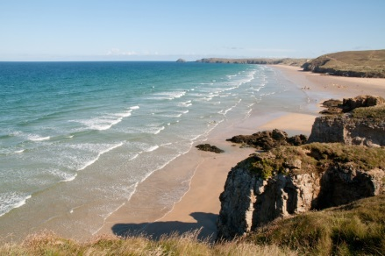
Transformational investment from Highways England (£17m) in partnership with Cornwall Council (£2m) for four new off road cycle trails including links between Newquay, Perranporth St Agnes and Truro.
Objectives
Address long standing severance issues caused by the trunk road
Improve connectivity for non car users
Mode shift ~ reduce congestion ~
Air quality benefits
Extend Cornwall tourism ‘offer’ for visitors and residents
Encourage healthy active lifestyles for all ages and users
Build on legacy of Environmental Growth projects
Building on the success of well established cycle routes such as the Camel Trail, these new routes will be built to a high standard and will be off road; enabling safe, healthy and fun journeys for commuters, families, school children and visitors.
Once completed this 30Km network of trails will link housing and employment growth areas’ connect coastal communities, provide sustainable access to key services and help address congestion and air quality issues.

Slide 3
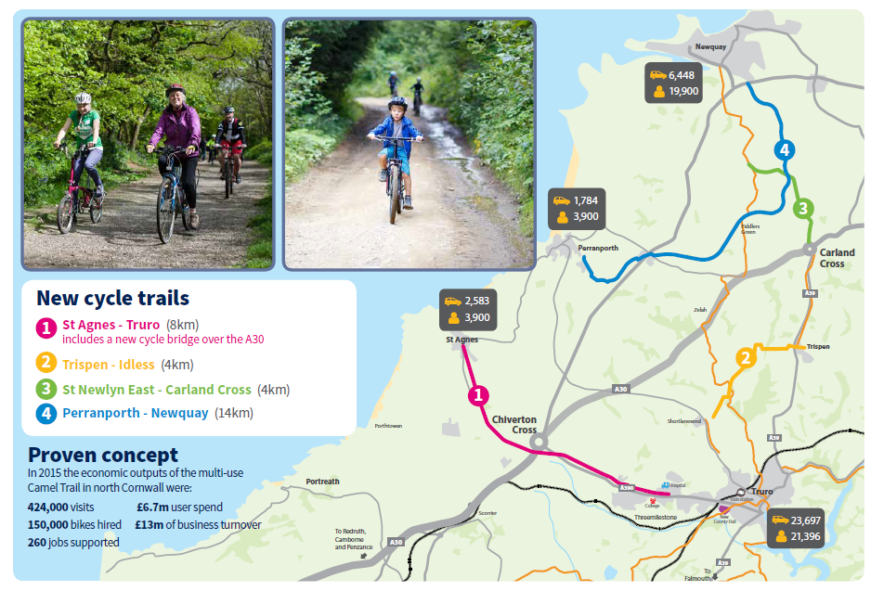

Slide 4
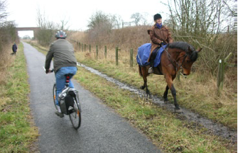
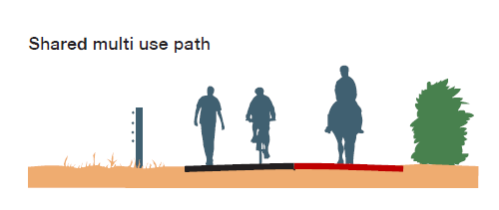
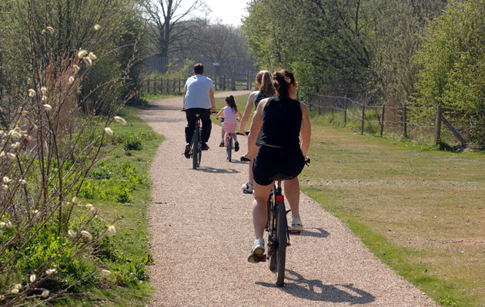
Core Design principles
Suitable for unaccompanied 12 year old cyclist, families and those ‘new’ to cycling
Separation from traffic on busy roads
3m min width surfaced cycle footway with provision for horse riders
Gradients kept to a minimum where possible
‘Camel trail’ standard – off road, high quality continuous routes for leisure and cycle commuting

Slide 5
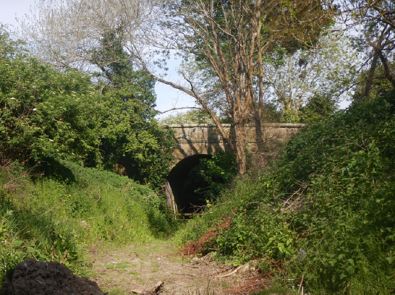
CSI Schemes - Perranporth to Newquay
WP1 Multi-use trail: proposal to adapt the route of the abandoned railway into a multi-use trail. The route starts in Perranporth and continues through St Newlyn East to Newquay creating a new 14km commuting and leisure route.
Opportunities and issues to address
Condition of remaining old railway track bed
Dismantled bridges
Maintaining route continuity

Slide 6
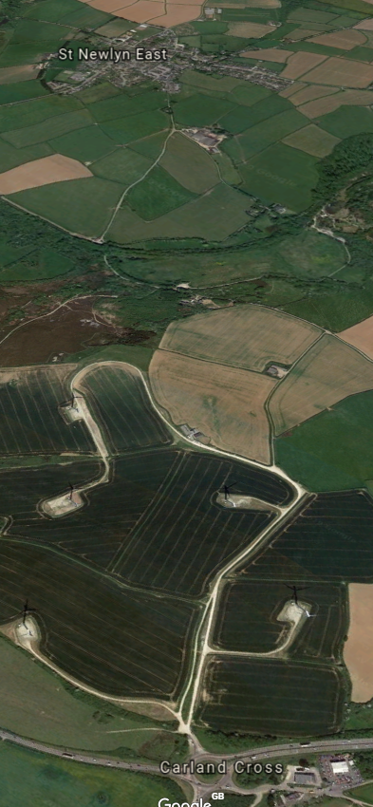
CSI Schemes -St Newlyn East to Carland Cross
WP2 Traffic–free path: proposal to connect the existing National Cycle Network (NCN) Route 32 at St Newlyn East to Carland Cross via a traffic-free path through Newlyn Downs.
Opportunities and issues to address
Quiet lanes from St Newlyn East
Security issues across Carland Downs wind farm
Overlap with Environmental project

Slide 7
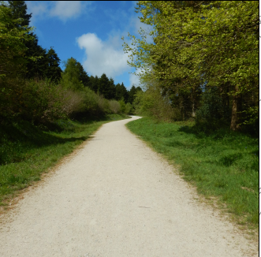
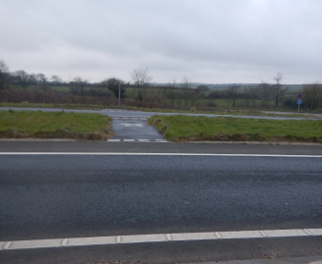
CSI Schemes - Trispen to Idless
WP4 Signed cycle route: Improvements to the rural lane network and woodland trails through Idless woods linking into NCN Route 32.
Opportunities and issues to address
Utilise existing forestry tracks through Idless woods
Links to existing NCN routes adjacent to A39
Crossing the A39

Slide 8
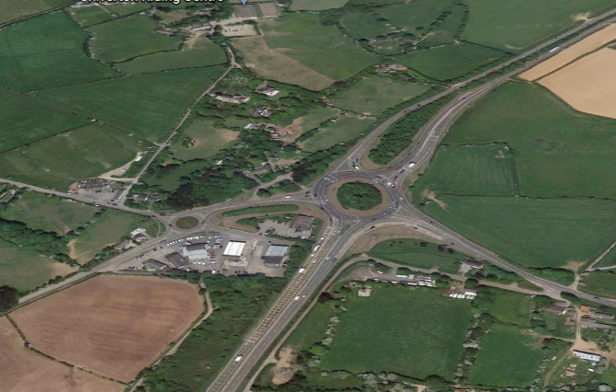
CSI Schemes - St Agnes to Threemilestone
WP5 Traffic-free path: proposal includes a new bridge crossing of the A30 Chiverton Cross junction, linking the A390 from Truro with the B3277 to St Agnes via off road cycle path. At the Truro end, the route would tie-in to the new facilities proposed at Threemilestone.
Opportunities and issues to address
High demand linking north coast to key sites - hospital, college, new Threemilestone development area and onwards to the city
Chiverton bridge
design options
Horse rider provision
Timing of construction and main dualling scheme

Slide 9
Next Steps and key milestones
Design Development
Spring 2019
Landowner engagement
Consultation
Autumn 2019
Planning permission (where required)
Spring 2021
Construction commences on rolling programme
Schemes open
End 2019/ early 2020
Summer 2019

Slide 10
Cornwall Contacts
Rick Clayton | Major Transport Scheme Lead, Cornwall Council | 01872 224685 | rick.clayton@cornwall.gov.uk
Doug Boden | Transport Principal Officer, Cornwall Council | 01872 322684 | douglas.boden@cornwall.gov.uk
James Lantsbery | Project Manager, CORMAC | 01209 616991 | james.lantsbery@cormacltd.co.uk

Slide 11
Any Questions

Slide 13
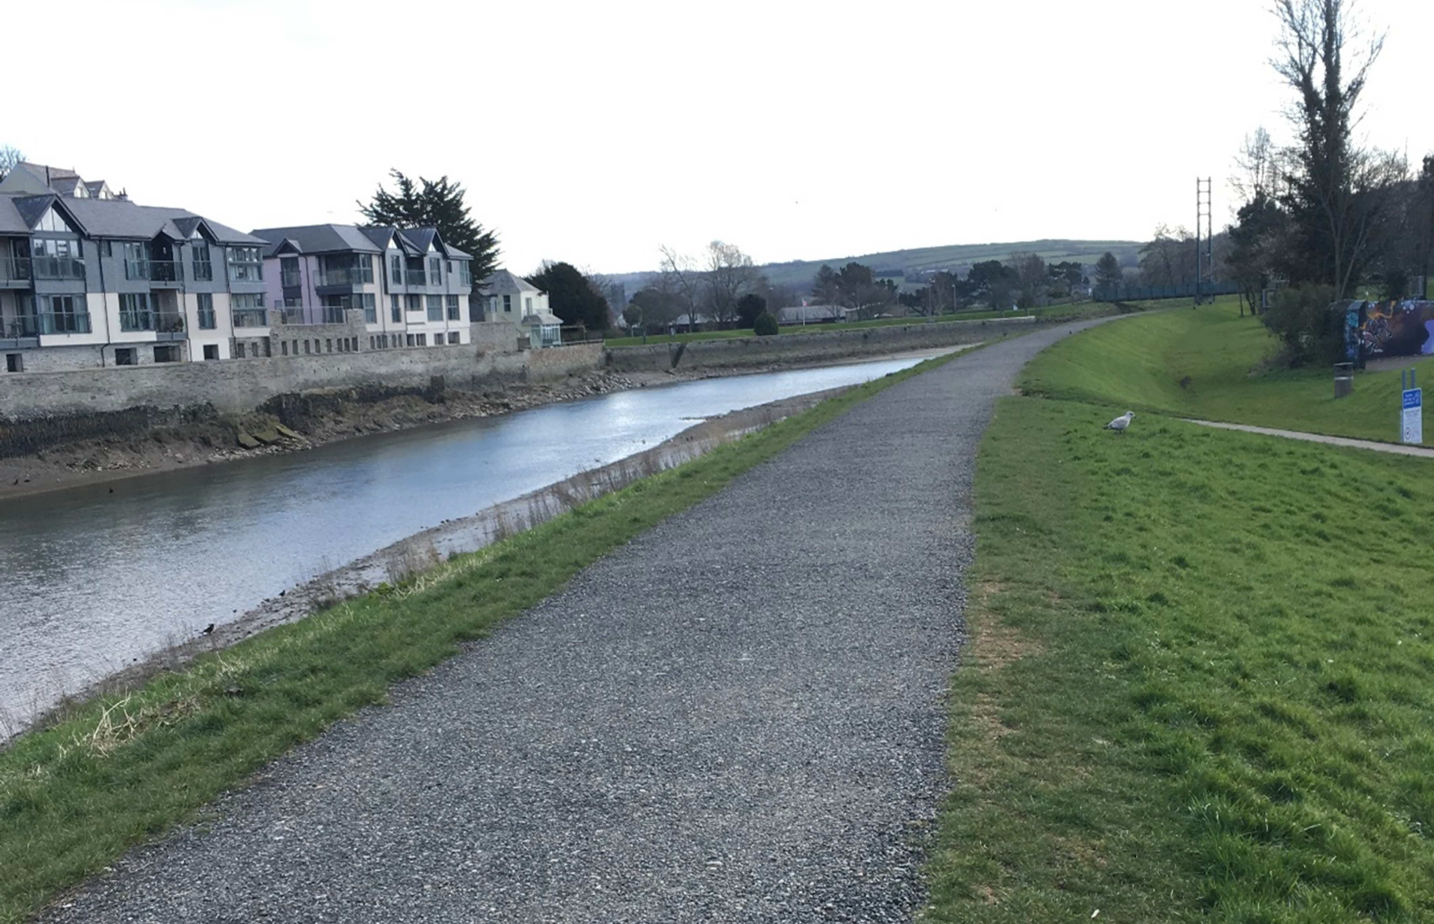

Slide 14
